Slide 1
Creating and Amending Data Structures
Data Definition Language

Slide 2
Learning Objectives
By the end of this lesson you will:
Have a deeper understanding of database structures
Understand how to connect to the Oracle database in DIT
Understand how to use send instructions to the database using SQL Developer
Understand how to create tables in an Oracle database (using SQL Developer interface)
Understand how to insert and retrieve data from these tables using SQL statements

Slide 3
Access a database
How to get access to the database?
You need to know the name of the database or schema
You need to have privilege view or create data within it
You need to create a connection to the database

Slide 4
Oracle Architecture
An Oracle database consists of:
A large amount of stored data on disk (in physical files)
An Oracle instance - set of memory structures that manage database files
Allows users to request services and manipulate the physical database
Without the instance, the Oracle database is not usable
It is like having a book and not being able to read.

Slide 5
Client / server architecture
The database application and the database are separated into two parts:
a front-end or client portion, and
a back-end or server portion

Slide 6
Client / server architecture
The client interacts with a user through the keyboard, screen, and pointing device, such as a mouse. It relays information to and from the server.
The server runs the Oracle software that accesses and manipulates the data on an Oracle database, for concurrent, shared data access.
The client and server may be on the same machine, but normally on a network, they are not.

Slide 7
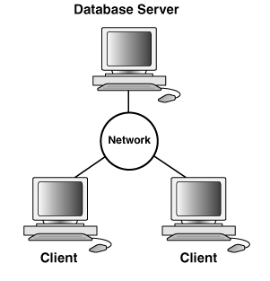
DIT Architecture
The data is held in a database on the server
Our server is called Redwood and is on the ICT domain - redwood.ict.ad.dit.ie
It hosts an Oracle 12c database.
We access and manipulate the data using an application on the client.
Our client application is SQL Developer.

Slide 8
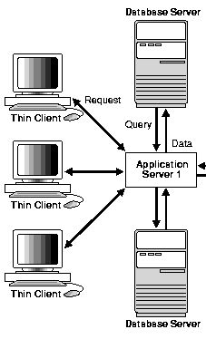
DIT Architecture
The client can access the database server through an application that sits on the server.
E.g. Over the network.
This requires an application on the server, that can interact with the database server.
The client then sends requests to the application server, which services them and returns a result.
The service we connect with is pdb12c.ict.ad.dit.ie

Slide 9
Architectures used in this module.
The lab and practical work should be carried out on the server provided:
A database server on redwood.ict.ad.dit.ie
Using the client:
A client with SQL Developer on the local lab image
Or
You can complete the practical work at home BUT you must be able to demonstrate it on the server provided by DIT.

Slide 10
DIT Oracle Architecture
Each of you has an Oracle account which allows you to create objects (tables, queries, views, reports) within the DIT Oracle database
Tablespace – logical space used for storage
Users are allocated to particular tablespaces
E.g. In DIT there is a separate tablespace for DT2282, DT2283, DT2284 etc

Slide 11
Creating Tables

Slide 12
Creating data structures in a databases
You need to know:
How to get access to the database
What things you want to store data about
What pieces of data you want to store about these things
What type of data you want to store

Slide 13
SQL: Data Definition Language (DDL) Commands
CREATE TABLE: used to create a table.
ALTER TABLE: modifies a table after it was created.
DROP TABLE: removes a table from a database.

Slide 14
Creating a Table
A table is an object that can store data in an Oracle database.
When you create a table, you must specify:
the table name,
the name of each column,
the data type of each column,
and the size of each column
any constraints on the data that each column can contain.

Slide 15
Example
Suppose we are a small lending library
What things do we need to store information about?
What information do we need to store about them?
BOOKS
BORROWERS/
PATRONS
TRANSACTIONS
(LOANS, FINES, REQUESTS ETC)

Slide 16
Example
What information do we need to store about them?
BOOKS
Title, Author, ?
BORROWERS/
PATRONS
Name, Address,?
TRANSACTIONS
(LOANS, FINES, REQUESTS ETC)
Type, Date, Book, Patron,

Slide 17
Example
How will we identify each book, patron, transaction?
BOOKS
BookID,Title, Author, ?
BORROWERS/
PATRONS
PatronID,Name, Address,?
TRANSACTIONS
(LOANS, FINES, REQUESTS ETC)
TransID,Type, Date, Book, Patron,

Slide 18
Key Constraints – Primary Key
Is an attribute or a set of attributes that uniquely identify a specific instance of an entity.
Every entity in the data model must have a primary key whose values uniquely identify instances of the entity.
Enforce entity integrity by uniquely identifying entity instances.

Slide 19
Key Constraints – Primary Key
To qualify as a primary key for an entity, an attribute must have the following properties:
it must have a non-null value for each instance of the entity
the value must be unique for each instance of an entity
the values must not change or become null during the life of each entity instance.

Slide 20
Key Constraints
Sometimes an entity will have more than one attribute that can serve as a primary key.
Any key or minimum set of keys that could be a primary key is called a candidate key.
Once candidate keys are identified, choose one, and only one, primary key for each entity.
Choose the identifier most commonly used by the user as long as it conforms to the properties required of a primary key.
Candidate keys which are not chosen as the primary key are known as alternate keys.

Slide 21
Key Constraints – Primary Key
Let's assume that for each employee in an organization there are three candidate keys:
Employee ID, PRSI Number, and Name.
Name is the least desirable candidate.
Even for a small company it would not be unusual for two people to have exactly the same name, more unusual for a large company.
There is the possibility that an employee's name could change because of marriage.
Employee ID would be a good candidate as long as each employee were assigned a unique identifier at the time of hire.
PRSI number could also work since every employee is required to have one before being hired.

Slide 22
Example
Suppose we decide to create three tables
Books where we will store the name of the book, first and last name of the author and a rating
Patrons where we will store the firstname, lastname and address of each patron
Transactions where will store details of all transactions with customers related to books borrowed by each patron including details of the book, the patron, what type of transaction and the date of the transaction

Slide 23
CREATE
The table name
Call your table a name that is short and sensible.
Reflect the names in your entity-relationship design.
The columns
The name, must be alpha-numeric, with no spaces or hyphens. It can contain underscores.
Date-published ✗
Date published ✗
Datepublished 
Date_published 

Slide 24
Naming Tables
Table names and column names:
Must begin with a letter
Must be 1–30 characters long
Must contain only A–Z, a–z, 0–9, _, $, and #
Must not duplicate the name of another object owned by the same user
Must not be an Oracle server reserved word

Slide 25
Create Table Statement
You must have:
CREATE TABLE privilege
Access to a storage area
You specify:
Table name
Column name, column data type, and column size, any constraints
CREATE TABLE [schema.]table
(column datatype [DEFAULT expr][, ...]);

Slide 26
Data Types
Data Type | Description
VARCHAR2(size) | Variable-length character data
CHAR(size) | Fixed-length character data
NUMBER(p,s) | Variable-length numeric data
DATE
LONG | Variable-length character data (up to 2 GB)
CLOB | Character data (up to 4 GB)
RAW and LONG RAW | Raw binary data
BLOB | Binary data (up to 4 GB)
BFILE | Binary data stored in an external file (up to 4 GB)
ROWID | A base-64 number system representing the unique address of a row in its table
Notes:
Data Types
When you identify a column for a table, you need to provide a data type for the column. There are several data types available:

Slide 27
Oracle Doesn’t do Booleans
You have to use a workaround.
You can mimic Booleans by denoting a single character or number and restrict the values that can be stored by using a constraint

Slide 28
Example
Suppose we realise it by creating the tables
BOOKS
BookID Datatype?
title ?
author_last_name ?
author_first_name ?
rating ? (an indicator of its popularity)

Slide 29
Create Books
CREATE TABLE books (
bookid NUMBER PRIMARY KEY,
title VARCHAR2(50),
author_last_name VARCHAR2(30),
author_first_name VARCHAR2(30),
rating NUMBER
);

Slide 30
Create Patrons
CREATE TABLE patrons (
patronid NUMBER PRIMARY KEY,
last_name VARCHAR2(30),
first_name VARCHAR2(30),
street_address VARCHAR2(50),
city_state_zip VARCHAR2(50)
);

Slide 31
Create Transactions
CREATE TABLE transactions (
transactionid NUMBER PRIMARY KEY,
patronid NUMBER,
bookid NUMBER,
transaction_date DATE,
transaction_type VARCHAR2(20)
);

Slide 32
Defining Primary Key
Defining primary key at Column-level:
Defining primary key at Table-level:
CREATE TABLE employees(
employee_id NUMBER(6) PRIMARY KEY,
first_name VARCHAR2(20),
job_id VARCHAR2(10) NOT NULL,
);
1
CREATE TABLE employees(
employee_id NUMBER(6),
first_name VARCHAR2(20),
job_id VARCHAR2(10) NOT NULL,
PRIMARY KEY (EMPLOYEE_ID));
2
Notes:
Defining Constraints (continued)
Constraints are usually created at the same time as the table. Constraints can be added to a table after its creation and also temporarily disabled.
Both slide examples create a primary key constraint on the EMPLOYEE_ID column of the EMPLOYEES table.
1. The first example uses the column-level syntax to define the constraint.
2. The second example uses the table-level syntax to define the constraint.
More details about the primary key constraint are provided later in this lesson.

Slide 33
Our Example
We have now created three containers for data - three tables
Each table represents on thing we want to store data about
Books, Patrons, Transactions
Each table has a set of columns which defines the type of data we want to store about the thing the table represents
Currently however we have no data – we simply have defined a structure

Slide 34
Lets first look at the structure of the data
We can ask the database to self-describe using the Describe Command
Describe books;
What can we deduce from this ?
Name Null Type
----------------- -------- ------------
BOOKID NOT NULL NUMBER
TITLE VARCHAR2(50)
AUTHOR_LAST_NAME VARCHAR2(30)
AUTHOR_FIRST_NAME VARCHAR2(30)
RATING NUMBER

Slide 35
Lets first look at the structure of the data
We can ask the database to self-describe
Describe books;
BookID – cannot have no value, allowed numbers only
Title –allowed characters to max length 50
Author_last_name - allowed characters to max length 30
Author_first_name - allowed characters to max length 30
Rating, can be blank, allowed numbers only
Title, Author_last_name, Author_first_name, Rating can have no value
Name Null Type
----------------- -------- ------------
BOOKID NOT NULL NUMBER
TITLE VARCHAR2(50)
AUTHOR_LAST_NAME VARCHAR2(30)
AUTHOR_FIRST_NAME VARCHAR2(30)
RATING NUMBER

Slide 36
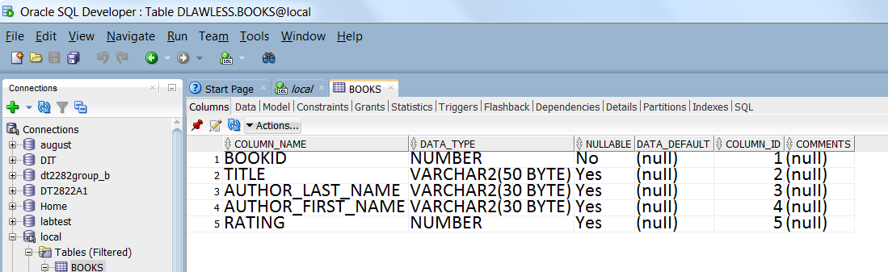
Lets first look at the structure of the data
We can use SQL Developer

Slide 37
Inserting Data

Slide 38
What you need to know
The format of the table
i.e. the columns and their constraints.
You can do either:
A full INSERT
This inserts a value for every column in the table.
A partial INSERT
This inserts some values, but accepts the default values for other columns.
Note:
All CHAR, VARCHAR2 and DATE fields must have their values surrounded by single quotes.

Slide 39
Book Table
CREATE TABLE books (
bookid NUMBER PRIMARY KEY,
title VARCHAR2(50),
author_last_name VARCHAR2(30),
author_first_name VARCHAR2(30),
rating NUMBER
);

Slide 40
To add a row we need to :
INSERT INTO table (column1, column2, ... column_n ) VALUES (expression1, expression2, ... expression_n );
INSERT INTO books VALUES (
100 , -- BookID
'Moby Dick', -- title
'Melville', -- author_last_name
'Herman', -- author_first_name
10 -- rating
);
NOTE: If we do not include a column list then ORACLE assumes you are inserting data in the column order it expects.

Slide 41
To add a row we need to :
INSERT INTO table (column1, column2, ... column_n ) VALUES (expression1, expression2, ... expression_n );
INSERT INTO books (title, author_last_name, author_first_name, BookID)
VALUES (
'Moby Dick', -- title
'Melville', -- author_last_name
'Herman', -- author_first_name
10, -- rating
100 -- BookID
);
NOTE: If we use a column list we can insert the data in the order we want

Slide 42
Duplicate Primary Key
Error starting at line : 38 in command -
INSERT INTO books VALUES (100, 'Moby Dick', 'Melville', 'Herman', 10)
Error report -
SQL Error: ORA-00001: unique constraint (DLAWLESS.SYS_C0020265) violated
00001. 00000 - "unique constraint (%s.%s) violated"
*Cause: An UPDATE or INSERT statement attempted to insert a duplicate key.
For Trusted Oracle configured in DBMS MAC mode, you may see
this message if a duplicate entry exists at a different level.
*Action: Either remove the unique restriction or do not insert the key.
INSERT INTO books VALUES (100, 'Moby Dick', 'Melville', 'Herman', 10);
If a book with a bookID of 100 already exists in the table….

Slide 43
Transactions and SQL
The SELECT statement reads data from the database
BUT doesn’t change anything.
The other three DML (data manipulation language) statements we will use DO change the data.
Because they change the data, the DBMS (Database Management System) goes into defensive mode.
It will not allow other users of the database make changes to this data until the statements are complete.

Slide 44
Transactions in SQL
As soon as Oracle sees an INSERT, UPDATE or DELETE, it starts a TRANSACTION
It LOCKS all rows that are subjected to
INSERT
UPDATE or DELETE
The transaction continues until the operations are either COMMITed or ROLLed BACK
COMMIT
This makes all of the operations permanent
ROLLBACK
This is like ‘undo’. It rolls back all operations carried out by the current session since the last COMMIT

Slide 45
COMMITs
Uncommitted data cannot be seen by other sessions
If I open two tables in two separate SQL worksheet windows and add rows in one, I won’t be able to see them in the other, until they are COMMITed.
If I delete rows in the other one, the first one will still see them until the DELETEs are committed

Slide 46
Transactions and locking
When an INSERT, UPDATE or DELETE takes place:
It starts a TRANSACTION - (or logical unitof work) a sequence of SQL statements that ORACLE treats as a single unit.
It locks the row that is being INSERTed / UPDATEd /DELETEd
Other sessions cannot see the changes that are being made
The lock holds until the transaction session issues
COMMIT or
ROLLBACK
A transaction ends with a:
commit,
rollback ,
exit, or any DDL statement which issues an implicit commit.
.

Slide 47
The Transaction Control Commands
Commit makes all changes since the beginning of a transaction permanent
Rollback rolls back (undoes) all changes since the beginning of a transaction
Other users cannot see the results of the transaction
until it has been committed.

Slide 48
Dropping a Table

Slide 49
Dropping a Table
All data and structure in the table are deleted.
Any pending transactions are committed.
All indexes are dropped.
All constraints are dropped.
You cannot roll back the DROP TABLE statement.
DROP TABLE dept80;
Table dropped.
Notes:
Dropping a Table
The DROP TABLE statement removes the definition of an Oracle table. When you drop a table, the database loses all the data in the table and all the indexes associated with it.
Syntax
DROP TABLE table
In the syntax, table is the name of the table.
Guidelines
All data is deleted from the table.
Any views and synonyms remain but are invalid.
Any pending transactions are committed.
Only the creator of the table or a user with the DROP ANY TABLE privilege can remove a table.
Note: The DROP TABLE statement, once executed, is irreversible. The Oracle server does not question the action when you issue the DROP TABLE statement. If you own that table or have a high-level privilege, then the table is immediately removed. As with all DDL statements, DROP TABLE is committed automatically.

Slide 50
Dropping Tables
When we create a set of SQL in a script to create and insert data we include statements to drop the tables at the start of that script
This will make sure out script clears out any old versions of our tables
If no tables exists then we will get the message
SQL Error: ORA-00942: table or view does not exist
00942. 00000 - "table or view does not exist"
*Cause:
*Action:
This is not a problem unless we are dropping something we expect to exist

Slide 51
Data Definition Language
Any DDL statement performs a COMMIT
A DDL statement is a Data Definition Language statement, such as CREATE, ALTER or DROP

Slide 52
Accessing Data

Slide 53
Accessing the data in a databases
Where the data is in the database?
You need to know the table structure
What the data means?
How each row is identified uniquely?
What items of data you need?
What parts of each row in the table is needed
You need to know the constraints. E.g
“I only want the items purchased in the last month”
“I only want to bill for items not paid for”

Slide 54
Accessing the data in a database
What format it is in?
What datatypes are used?
What you want to know or calculate from the data?
Are you looking at unit prices and an amount used ? Do you need to calculate a total?
How it should be presented?
Do you want to give the data a different name?
Do you want to present it in a different format? E.g. rounding up to the nearest euro?

Slide 55
Accessing the data in a databases
What can we find out from the Books table?
How can we instruct the DBMS?

Slide 56
The SELECT Statement
This is the most powerful and complex of the SQL statements.
Its structure is reasonably simple:
SELECT columns FROM tables WHERE condition;
There are other rules that can be added later.

Slide 57
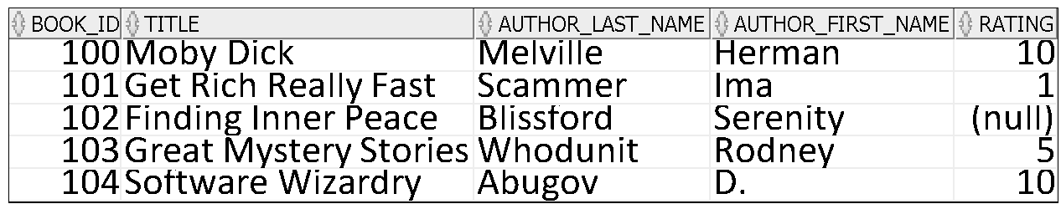
Find me everything
Select statement format:
SELECT columns FROM tables WHERE conditions;
To select all rows and columns from a table called Books
SELECT * FROM Books;
* denotes all available columns

Slide 58
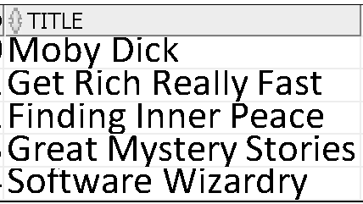
Find me only specific pieces of information
Select statement format:
SELECT columns FROM tables WHERE conditions;
To select the title from Books
SELECT title FROM Books;
By picking one single column we have taken a PROJECTION from the table

Slide 59
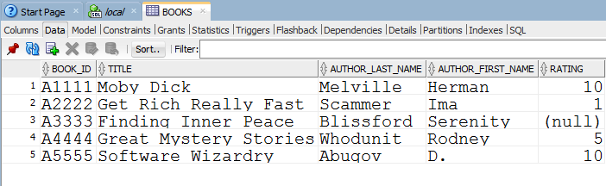
Accessing the data in a databases
What can we find out from the Books table?
Suppose we want to find out which books, showing their titles to the user rather than the id, have a rating less than 10
We are setting a criteria based on the values in the RATING column
We want to ask the database only to report to use those rows that meet this criteria
So we need to instruct it

Slide 60

How do we answer the question?
This requires that we filter the data using the WHERE CLAUSE
We need therefore to add a condition
Select title from books where rating<10;
This returns a reduced list:
By using a WHERE Clause we have implemented a RESTRICTION on the table

Slide 61
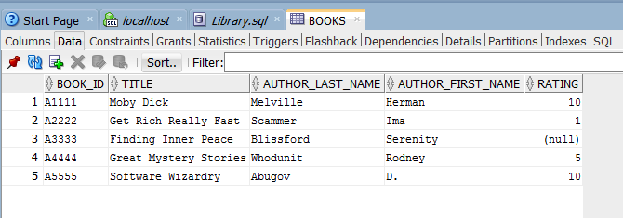
Did we get the correct answer
This was our original data:
This is our result:
Is this what you expected?

Slide 62
Oracle NULL values
NULL values represent missing or unknown data.
NULL values are used as placeholders or as the default entry in columns to indicate that no actual data is present.
The NULL is untyped in SQL, meaning that it is not an integer, a character, or any other specific data type.
It is not the same as an empty data string or the numerical value '0'.
While NULL indicates the absence of a value, the empty string and numerical zero both represent actual values.
Because NULL does not represent or equate to a data type, you cannot test for NULL values with any comparison operators, such as =, <, or <>.
The IS NULL and IS NOT NULL operators are used to test for NULL values.

Slide 63

How do we answer the question?
We need to add something to the Where Clause
We need therefore to add a condition
Select title from books where rating<10 or rating is null ;
This returns the list:
We can use the Boolean Operators AND, OR and NOT within a where clause to create Boolean expressions to fully define the restriction we want to apply

Slide 64
Oracle NULL values
NULL values represent missing or unknown data.
NULL values are used as placeholders or as the default entry in columns to indicate that no actual data is present.
The NULL is untyped in SQL, meaning that it is not an integer, a character, or any other specific data type.
It is not the same as an empty data string or the numerical value '0'.
While NULL indicates the absence of a value, the empty string and numerical zero both represent actual values.
Because NULL does not represent or equate to a data type, you cannot test for NULL values with any comparison operators, such as =, <, or <>.
The IS NULL and IS NOT NULL operators are used to test for NULL values.

Slide 65
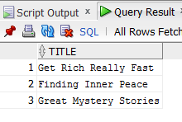
So to truly answer the question
Which books have a rating less than 10
We need to add another condition
Select title from books where rating<10 or rating IS NULL;
This returns the list:

Slide 66
Boolean Expressions
Operator | Explanation and Example | Syntax
AND, OR, NOT | Evaluate any operand(s) that are boolean expressions (orig_airport = 'SFO') OR (dest_airport = 'GRU') -- returns true | { Expression AND Expression | Expression OR Expression | NOT Expression }
Comparisons | <, =, >, <=, >=, <> are applicable to all of the built-in types. | Expression { < | = | | <= | >= | <> } Expression
IS NULL, IS NOT NULL | Test whether the result of an expression is null or not. | Expression IS [ NOT ] NULL

Slide 67
Boolean Expressions
Operator | Explanation and Example | Syntax
LIKE | Attempts to match a character expression to a character pattern, which is a character string that includes one or more wildcards. % matches any number (zero or more) of characters in the corresponding position in first character expression. city LIKE ‘S%’ – all cities starting with S _ matches one character in the corresponding position in the character expression. Any other character matches only that character in the corresponding position in the character expression. city LIKE ‘_sant‘ – all cities starting with any character followed by sant | CharacterExpression [ NOT ] LIKE CharacterExpression WithWildCard [ ESCAPE 'escapeCharacter']

Slide 68
Boolean Expressions
Operator | Explanation and Example | Syntax
BETWEEN | Tests whether the first operand is between the second and third operands. The second operand must be less than the third operand. Applicable only to types to which <= and >= can be applied. WHERE booking_date BETWEEN DATE('1998-02-26') AND DATE('1998-03-01') | Expression [ NOT ] BETWEEN Expression AND Expression
IN | Operates on table subquery or list of values. Returns TRUE if the left expression's value is in the result of the table subquery or in the list of values. Table subquery can return multiple rows but must return a single column. SELECT * FROM employees WHERE job_id IN ('PU_CLERK','SH_CLERK'); | { Expression [ NOT ] IN TableSubquery | Expression [ NOT ] IN ( Expression [, Expression ]* )

Slide 69
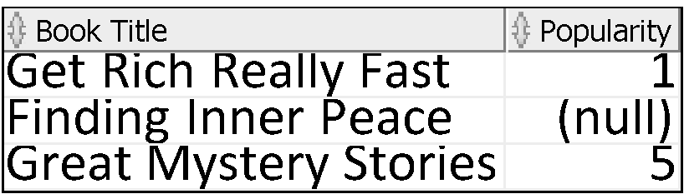
Changing the output
We can change the way the output will be presented to the user e.g.
select title "Book Title", rating "Popularity" from books where rating<10 or rating IS NULL;

Slide 70

Suppose we only want to look at books by a particular author?
Select title from books where author_last_name =‘Abugov’ and rating<10 or rating IS NULL;
Note the single quotes around the string we are trying to match
BE AWARE:
If you cut and paste from powerpoint into SQL Developer, it will not recognise the quotes – you will need to re-enter them

Slide 71
The Techniques We Have Used
Projection – filtering out unwanted columns.
Renaming – using alternate titles
Condition – boolean operators
Restriction – filtering out unwanted rows

Slide 72
Additional Tutorials and Demos Practicing SQL
Everyone should create an account on the Oracle Technology Network
This is free and gives you access to a range of tutorials and demos for free
http://www.oracle.com/technetwork/index.html
Use a third party site to allow you to practice your SQL.
Try http://sqlzoo.net/wiki/Main_Page

